Slide 1
Name : Dhanasekaran S A
NM.ID : au730321243004
RegNo : 730321243004
Dept : B.Tech AI and DS
Year : 3rd-year
College : Builders Engineering College

Slide 2
NEXT WORD PREDICTOR
A Introduction to the next word predictor aiming to develop a predictive algorithm based on models and natural language processing tecniques.

Slide 3


AGENDA
Introduction and Overview
Project Scope and Requirement
Data Collection and Preprocessing
Model Selection and Development
Integration and Deployment
Testing and Evaluation
Documentation and User Support
3/21/2024 Annual Review

Slide 4

PROBLEM STATEMENT
The objective of this project is to develop a robust and efficient next word predictor that accurately anticipates the next word or phrase based on user input. The predictor should seamlessly integrate into existing text-based applications and provide real-time suggestions to enhance user typing experience.
Key Challenges
Data Collection and Preprocessing
Model Selection and Training
Real-time Performance
Out-of-Vocabulary Handling
User Engagement and Feedback

Slide 5
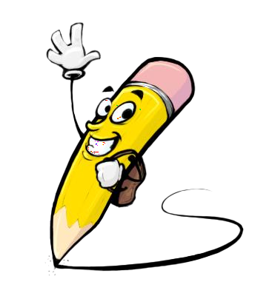
PROJECT OVERVIEW
Next Word Predictor aims to revolutionize text input experiences by accurately predicting the next word or phrase a user intends to type. Leveraging advanced natural language processing (NLP) techniques and machine learning algorithms, the project seeks to enhance typing efficiency, reduce cognitive load, and facilitate faster communication across various text-based applications.
Objectives:
1.Develop a robust next word prediction system capable of accurately anticipating the next word or phrase based on user input.
2.Optimize prediction models for real-time performance and efficient resource utilization across different platforms (e.g., mobile devices, web browsers).
3.Implement strategies for handling out-of-vocabulary words and continuously improving prediction accuracy through user feedback and data-driven approaches.

Slide 6

WHO ARE THE END USERS?
The end users of the Next Word Predictor can vary across different contexts and applications. Here are some examples of potential end users:
Mobile Device Users
Desktop Software Users
People with Disabilities
Language Learners
Professionals
Elderly Users
Students

Slide 7

SOLUTION AND ITS VALUE PROPOSITION
The Next Word Predictor is a cutting-edge predictive text technology designed to anticipate and suggest the next word or phrase as users type. Leveraging advanced natural language processing (NLP) algorithms and machine learning models, our solution revolutionizes text input experiences across various platforms and applications.
Key components:
1.Real-Time Predictive Engine
2.Adaptive Learning Macanism
3.Out-of-vocabulary andling
Value Proposition:
Enhanced Typing Efficiency
Improved User Experience
Increased Productivity
Accessibility and Inclusivity

Slide 8

THE WOW FACTORS:
Instantaneous and Accurate Predictions: Users are amazed by the predictor's ability to anticipate their next word or phrase with remarkable accuracy and speed. The predictions appear instantaneously as they type, creating a fluid and intuitive typing experience that feels almost magical.
Personalized Suggestions: The predictor adapts to individual writing styles and preferences, providing personalized suggestions that resonate with each user. By learning from user interactions and feedback, the predictor tailors its predictions to match the user's unique linguistic patterns, enhancing user engagement and satisfaction.
Seamless Integration Across Platforms: Whether on mobile devices, desktop software, or web browsers, the predictor seamlessly integrates into various platforms and applications, offering consistent and reliable predictive capabilities wherever users need them. This versatility astonishes users, who appreciate the predictor's ubiquity and accessibility.
3/21/20

Slide 9
MODELLING
Models:
Simpler models predict based on recent words (n-grams).
RNNs are powerful but struggle with long sequences.
LSTMs excel at capturing long-term dependencies in sequences, making them ideal for next word prediction.
Training:
Large text datasets are used to train the model.
The model learns relationships between words and predicts the next likely word.
Advanced Techniques:
Bidirectional LSTMs consider context from both sides for better predictions.
Smoothing techniques address unseen words in n-gram models.
By leveraging these techniques, NLP can create robust next word prediction models that enhance various applications and user experiences.

Slide 10
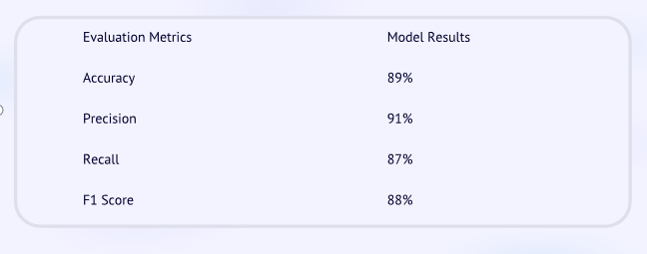
RESULTS
Project Link

